Slide 1
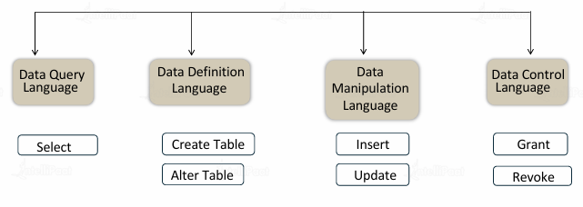
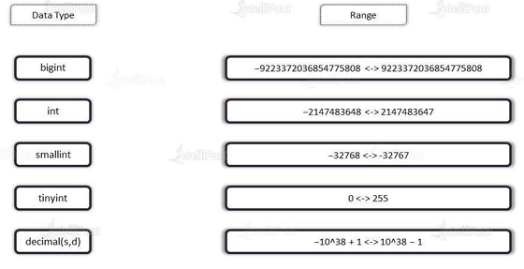
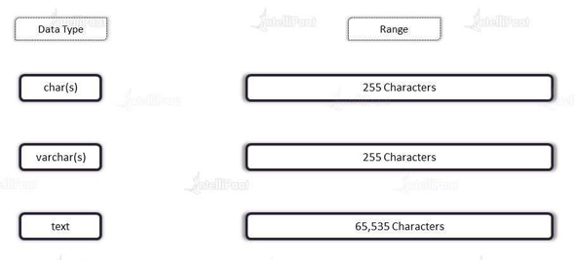
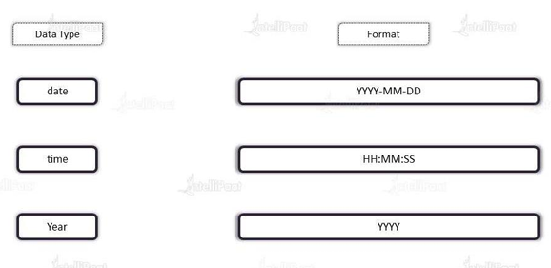
CREATE DATABASE databaseName ;
USE [DataBaseName] ;
DROP DATABASE databasename ;
Constraints: Rules for the data in a table can be specified using SQL constraints. The kinds of data that can be entered into a table are restricted by constraints. This validates the reliability and accuracy of the data in the table
NOT NULL
UNIQUE
PRIMARY KEY
FOREIGN KEY
CHECK
DEFAULT
The foreign key constraint is used to prevent actions that would destroy links between tables.
The foreign key constraint also prevents invalid data from being inserted into the foreign key column, because it has to be one of the values contained in the table it points to.
Bigint
Int
Smallint
Tinyint
Decimal(s,d)
Char(s)
Varchar(s)
text
Date
Time
Year
Name of the table -> define the columns -> Assign data types to columns

Slide 2
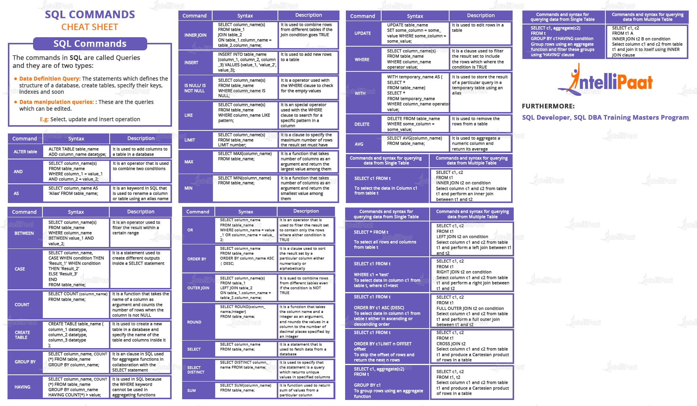

Slide 3
Module 1

Slide 4
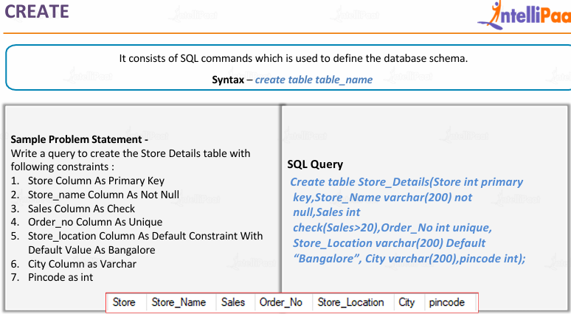
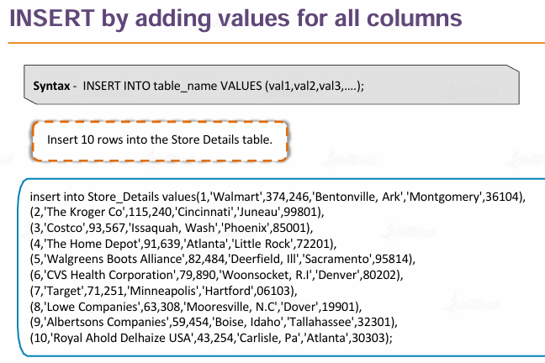
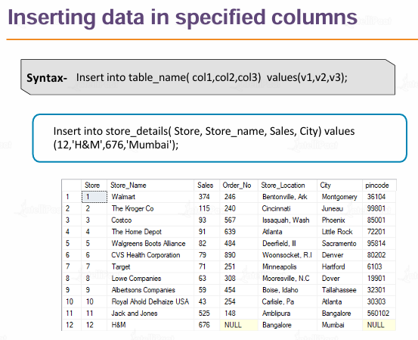
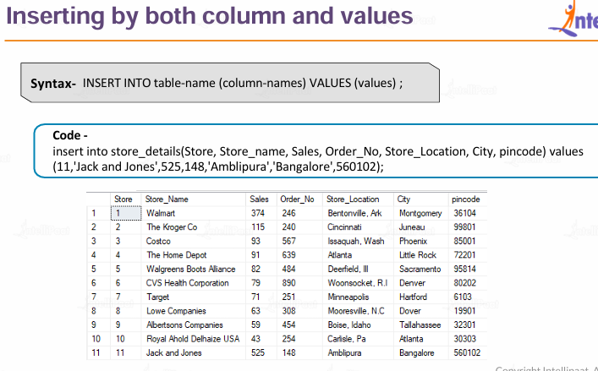

Slide 5
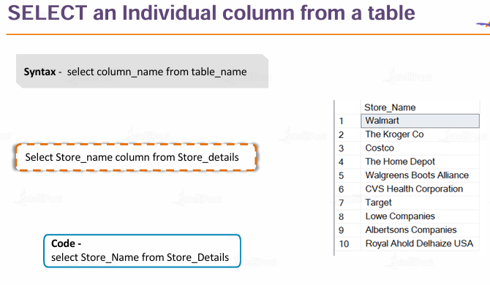
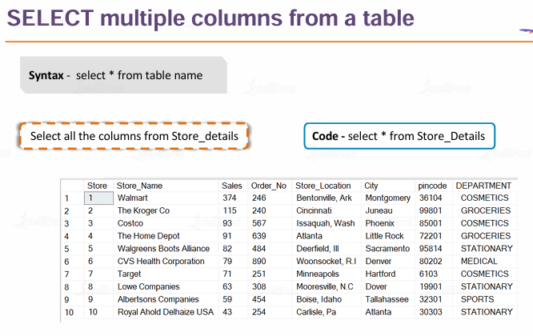
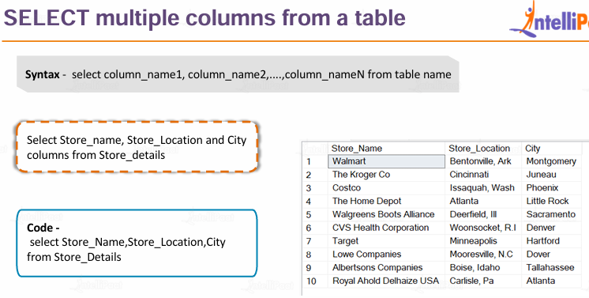

Slide 6
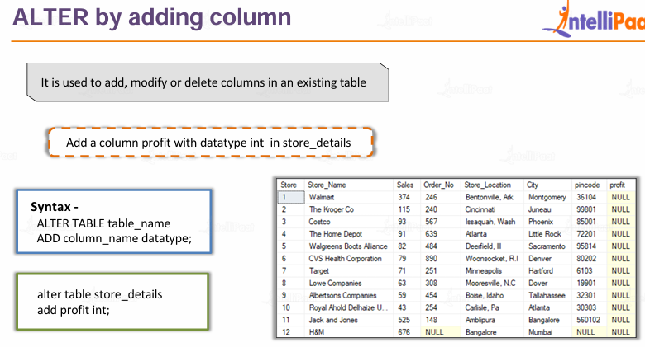
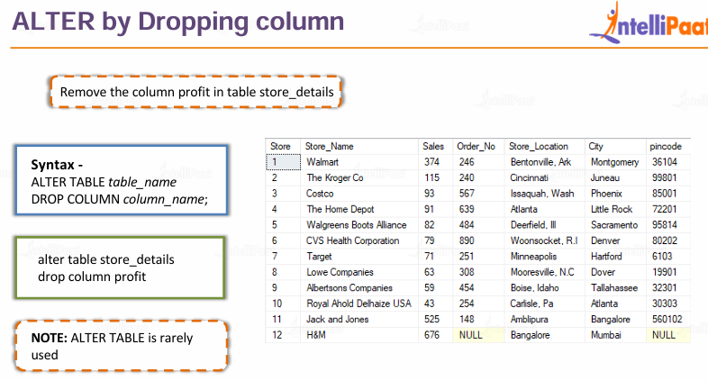

Slide 7
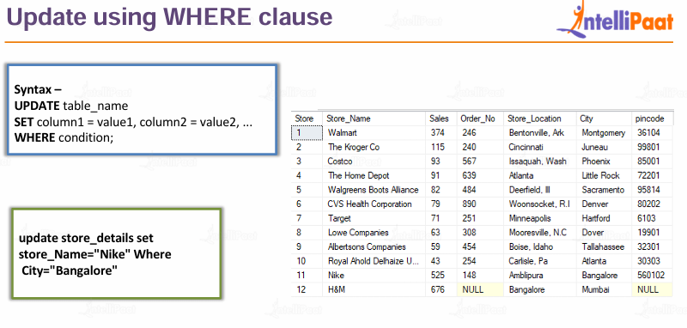
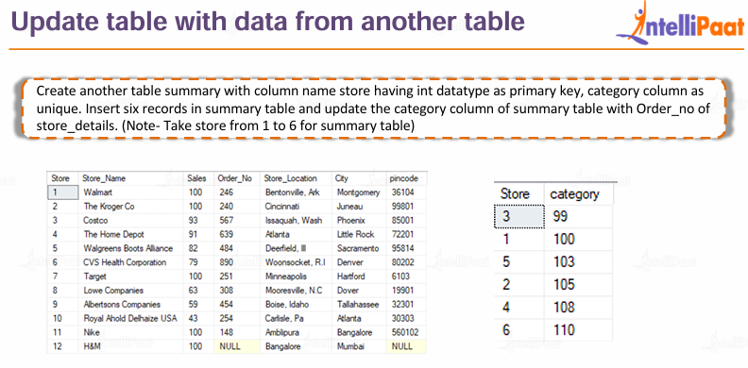
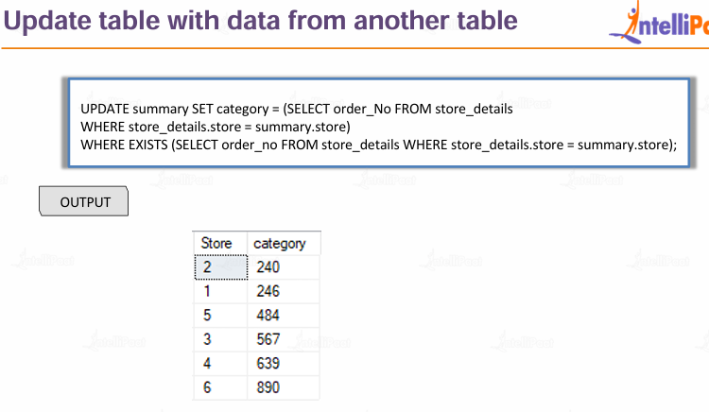
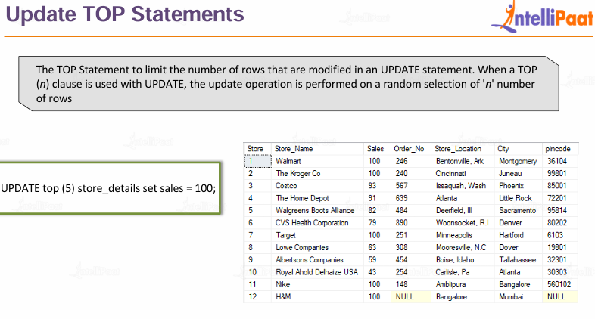
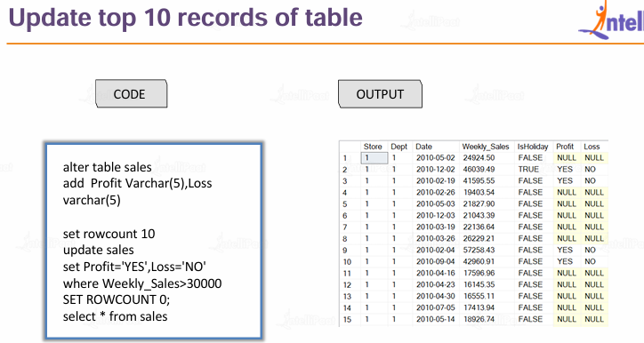

Slide 8
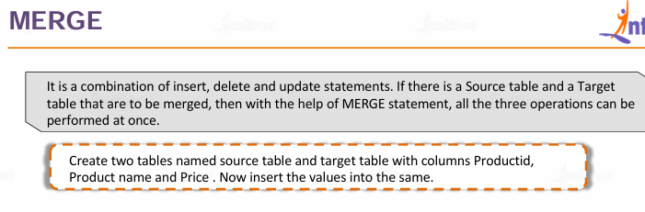
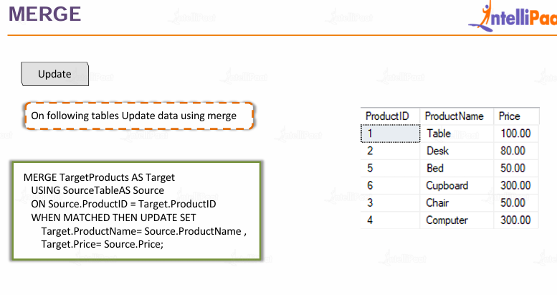
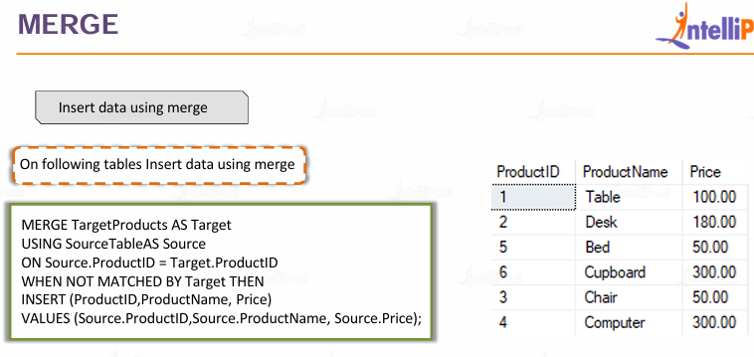
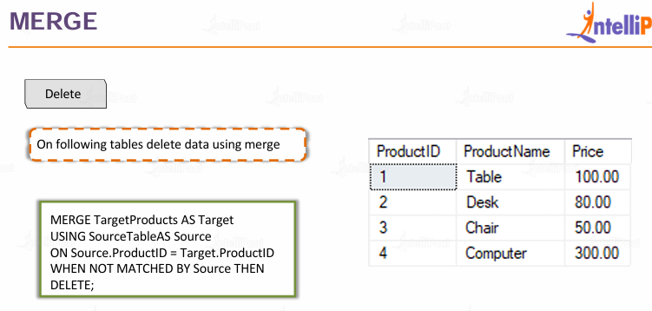

Slide 9
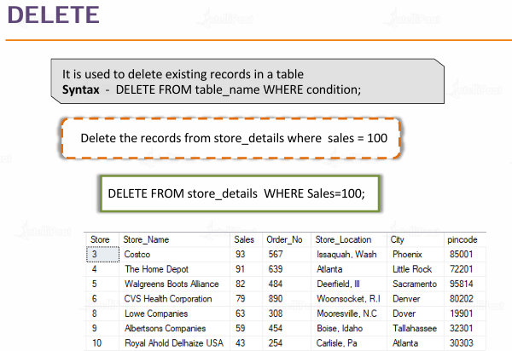
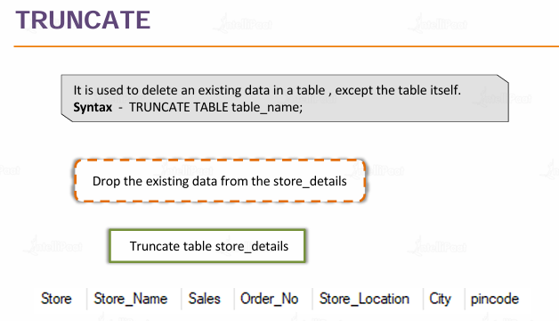
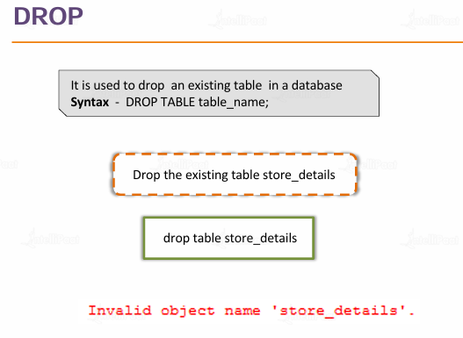

Slide 10
Module 2

Slide 11
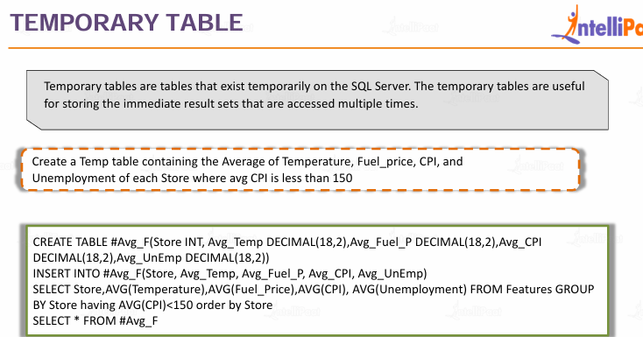
AND
OR
NOT
UNION
UNION ALL
INTERSECT
EXCEPT
LIKE
BETWEEN-Range
IN-List of values
Temporary Table CREATE TABLE #table_name();
WHERE
GROUP BY
ORDER BY
HAVING

Slide 12
Module 3
Joins
INNER JOIN
LEFT JOIN
RIGHT JOIN
FULL JOIN

Slide 13
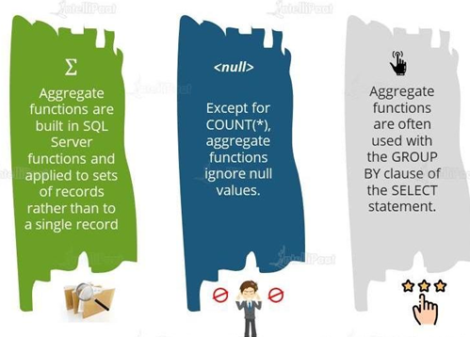
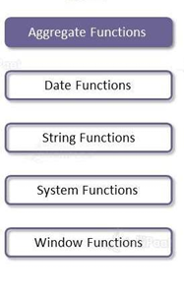
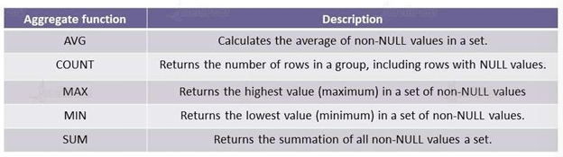
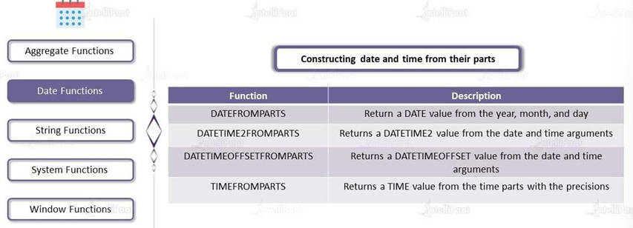
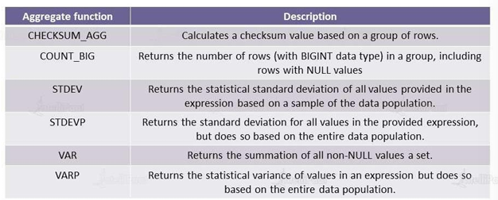
Module 4

Slide 14
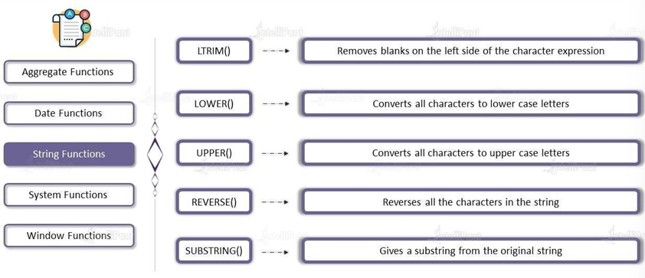
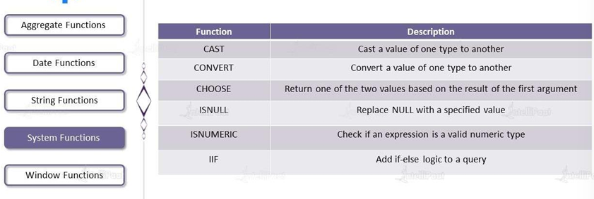
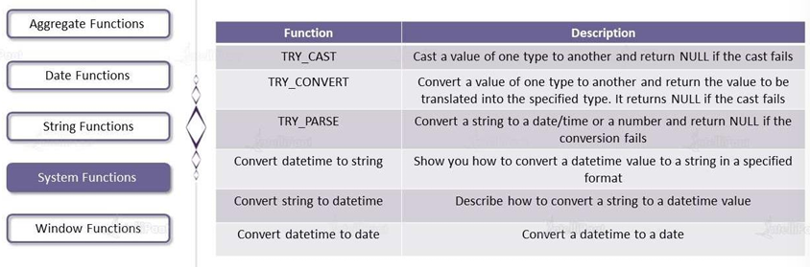

Slide 15
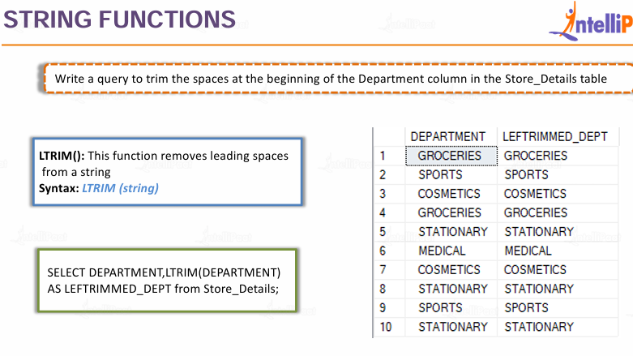
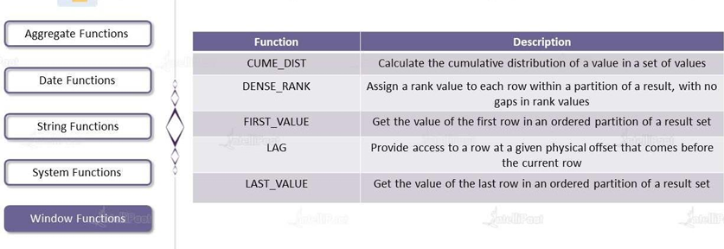
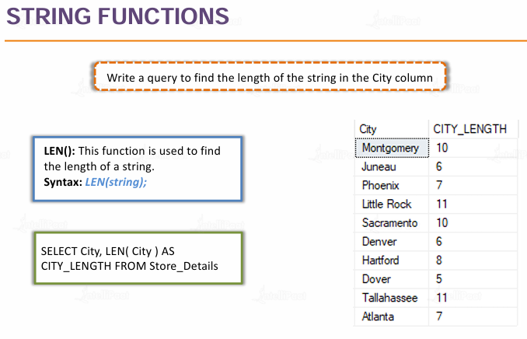
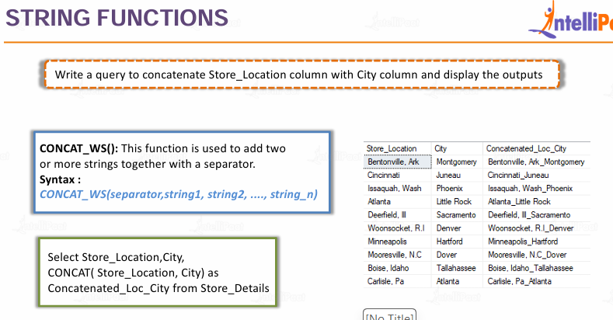
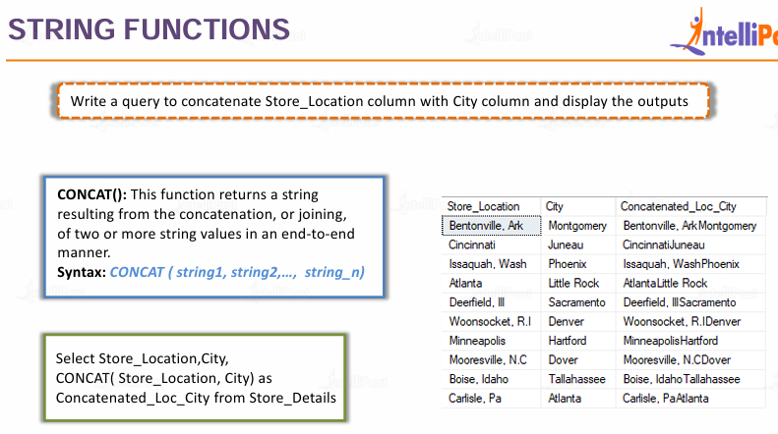
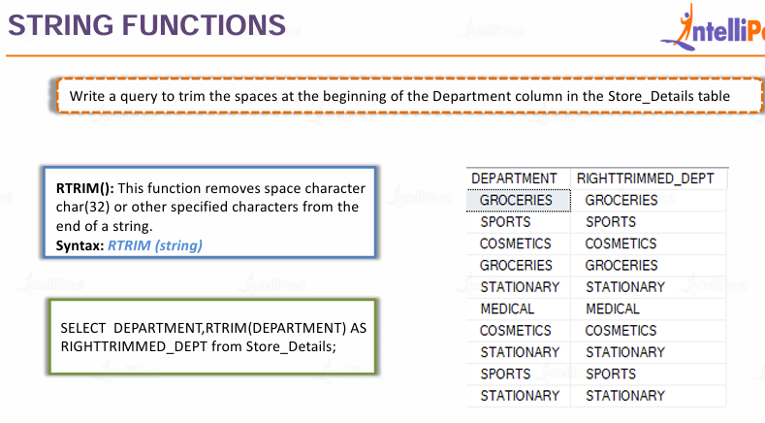

Slide 16
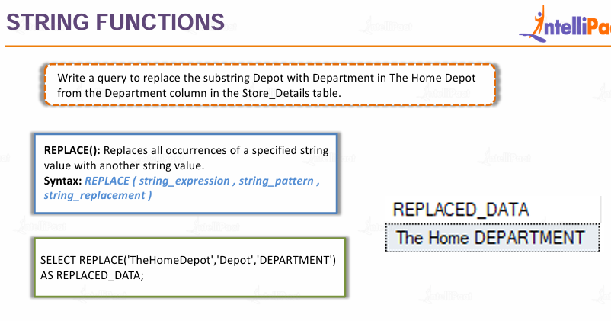
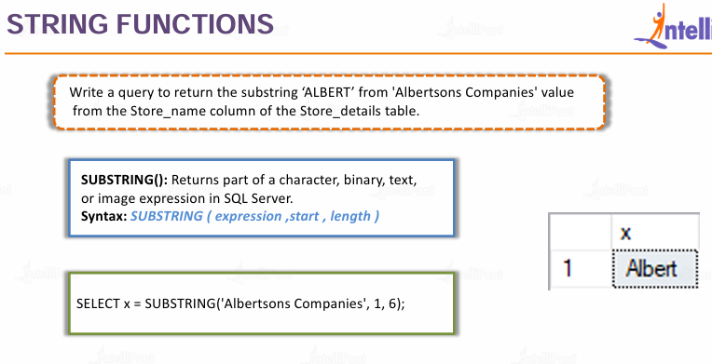
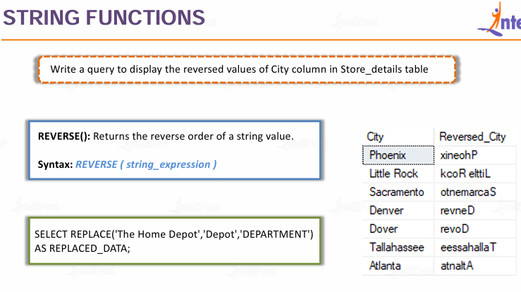
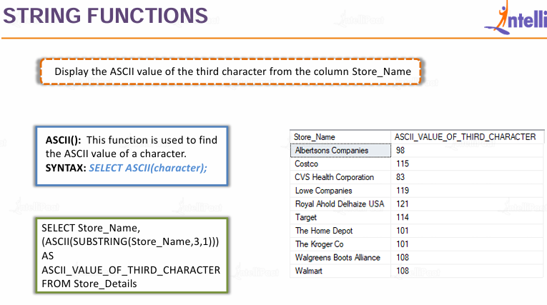

Slide 17
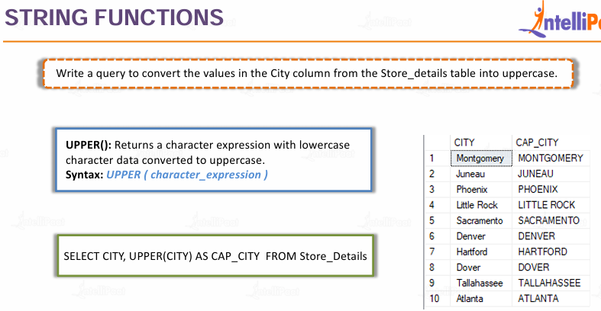
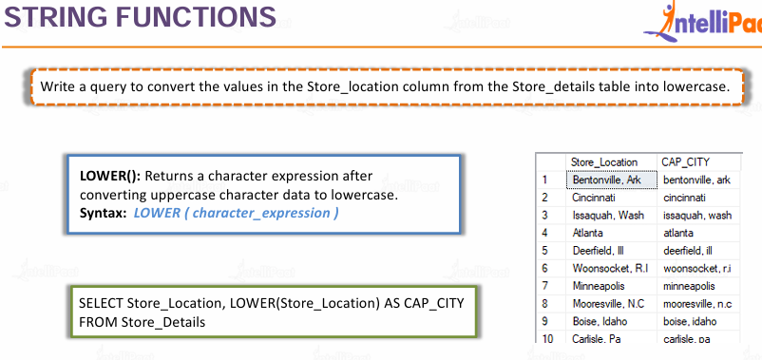

Slide 18
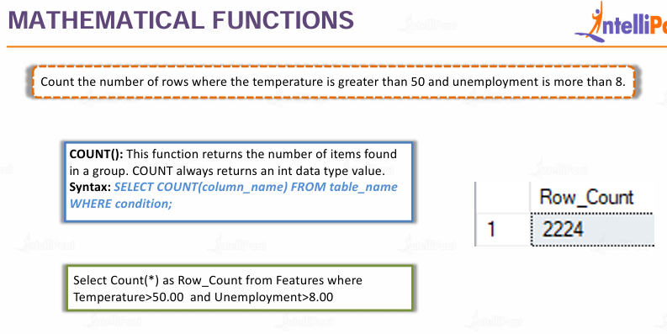
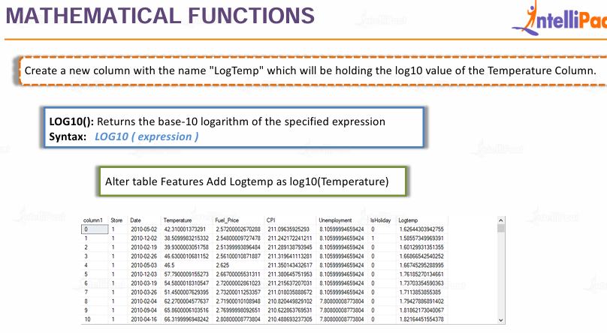
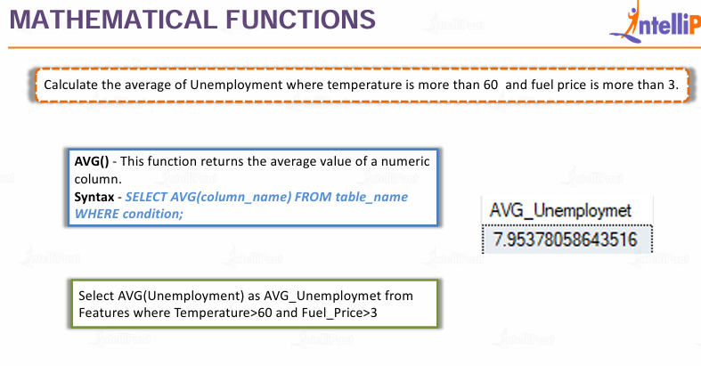



Slide 19





Slide 20








Slide 21



Slide 22





Slide 23

In SQL, the RANK() function is a window function that assigns a ranking value to each row within a result set based on a specific ordering. It is primarily used to create leaderboards, identify top-performing records, or filter data by its relative position
How RANK() Works
The fundamental characteristic of RANK() is how it handles ties:
Identical values get the same rank: If two rows have the same value for the ordering criteria, they receive the same rank number.
Gaps in the sequence: When ties occur, the function "skips" subsequent numbers to account for the duplicate ranks. For example, if two rows are tied for 1st place, the next row will be ranked 3rd (rank 2 is skipped).
SELECT
name,
department,
salary,
RANK() OVER (PARTITION BY department ORDER BY salary DESC) as salary_rank
FROM employees;
RANK() OVER (
[PARTITION BY expression, ...]
ORDER BY expression [ASC | DESC]
)
OVER: Mandatory clause that defines the "window" or scope of rows for the ranking.
PARTITION BY (Optional): Divides the result set into groups (e.g., ranking students within each subject separately).
ORDER BY: Specifies the column and direction (ascending or descending) used to determine the rank.

Slide 24


SELECT
Department,
Name,
Salary,
RANK() OVER (PARTITION BY Department ORDER BY Salary DESC) as DeptRank
FROM Employees;
The PARTITION BY clause is used to divide a result set into smaller groups, or "partitions," before a window function (like RANK(), SUM(), or ROW_NUMBER()) is applied.
Think of it as a "Reset" button for your calculations. Instead of treating the whole table as one big list, PARTITION BY tells SQL to perform the calculation separately for each category you define.
How it Works
Divide: It segments the data based on the unique values in the column(s) you specify.
Process: The window function runs independently within each segment.
Reset: When the query moves from one segment to the next, the calculation (like a rank or a sum) starts over from 1 or 0.

Slide 25
To master PARTITION BY, keep these critical rules in mind to avoid common logic errors and performance bottlenecks:
1. It Does Not Collapse Rows
Unlike GROUP BY, which combines multiple rows into a single summary row, PARTITION BY keeps every single row visible. It simply adds the calculation (like a rank or total) as a new column next to your existing data. Microsoft SQL Server Docs
2. The "Restart" Logic
Whenever the value in your partitioned column changes, the window function resets to its starting value (e.g., ROW_NUMBER starts back at 1). If you don't use PARTITION BY, the function treats the entire result set as one giant group.
3. Order of Operations
The PARTITION BY clause is applied after the FROM, WHERE, and GROUP BY clauses, but before the final ORDER BY of the query.
Crucial: You cannot use window function results in a WHERE clause directly. To filter by a partition rank (e.g., "Top 3 per category"), you must use a Subquery or a Common Table Expression (CTE). PostgreSQL Window Function Tutorial
4. Multiple Columns Are Allowed
You can partition by more than one column to create "nested" groups.
Example: PARTITION BY Country, State will reset the ranking every time the State changes within a Country.
5. Performance Considerations
Partitioning large datasets can be resource-intensive because the database must sort the data into buckets. To optimize:
Ensure the columns used in PARTITION BY and the inner ORDER BY are indexed.
Avoid partitioning by columns with extremely high cardinality (unique values in almost every row) unless necessary.
6. NULLs are a Group
In SQL, NULL values are treated as a distinct group. If your partitioned column has nulls, all rows with NULL will be grouped into one partition and ranked/calculated together. Oracle Window Function Guide

Slide 26




Slide 27
SELECT
Name,
Salary,
NTILE(4) OVER (ORDER BY Salary DESC) AS Quartile
FROM Employees;
WITH RankedSales AS (
SELECT
EmployeeName,
SalesAmount,
NTILE(4) OVER (ORDER BY SalesAmount DESC) AS Quartile
FROM SalesTeam
)
SELECT *
FROM RankedSales
WHERE Quartile = 1; -- Only returns rows in the top 25% bucket

Slide 28
1. Ranking Functions
These assign a numerical rank to each row within a partition based on a specific order.
RANK(): Assigns ranks with gaps for ties (1, 1, 3, 4).
ROW_NUMBER(): Assigns a unique, sequential integer to rows (1, 2, 3, 4).
DENSE_RANK(): Assigns ranks without gaps for ties (1, 1, 2, 3).
PERCENT_RANK(): Calculates the relative rank of a row as a percentage (0 to 1).
CUME_DIST(): Calculates the cumulative distribution of a value within a group.
NTILE(n): Divides rows into n approximately equal groups or buckets.
2. Value (Analytic) Functions
These allow you to "look" at other rows relative to the current row without using a self-join.
LAG(): Accesses data from a previous row.
LEAD(): Accesses data from a subsequent row.
FIRST_VALUE(): Returns the first value in an ordered set or partition.
LAST_VALUE(): Returns the last value in an ordered set or partition.
NTH_VALUE(): Retrieves a value from a specific row (the n-th row) in the window.
3. Aggregate Window Functions
Standard aggregate functions become window functions when used with the OVER() clause. Unlike regular aggregates, they do not collapse rows.
SUM(): Calculates a running or partitioned total.
AVG(): Calculates moving or partitioned averages.
COUNT(): Counts rows within the defined window.
MIN() / MAX(): Finds the smallest or largest value in the window.
STDEV() / VAR(): Calculates statistical standard deviation or variance (supported in some dialects like SQL Server).

Slide 29
SELECT
Region,
SaleDate,
Revenue,
-- 1. RANKING FUNCTIONS
ROW_NUMBER() OVER (PARTITION BY Region ORDER BY Revenue DESC) as RowNum,
RANK() OVER (PARTITION BY Region ORDER BY Revenue DESC) as RankVal,
DENSE_RANK() OVER (PARTITION BY Region ORDER BY Revenue DESC) as DenseRankVal,
NTILE(4) OVER (PARTITION BY Region ORDER BY Revenue DESC) as Quartile,
-- 2. VALUE / ANALYTIC FUNCTIONS
LAG(Revenue, 1) OVER (PARTITION BY Region ORDER BY SaleDate) as PrevMonthRevenue,
LEAD(Revenue, 1) OVER (PARTITION BY Region ORDER BY SaleDate) as NextMonthRevenue,
FIRST_VALUE(Revenue) OVER (PARTITION BY Region ORDER BY SaleDate) as FirstMonthInRegion,
LAST_VALUE(Revenue) OVER (PARTITION BY Region ORDER BY SaleDate
ROWS BETWEEN UNBOUNDED PRECEDING AND UNBOUNDED FOLLOWING) as LastMonthInRegion,
-- 3. AGGREGATE WINDOW FUNCTIONS
SUM(Revenue) OVER (PARTITION BY Region ORDER BY SaleDate) as RunningTotal,
AVG(Revenue) OVER (PARTITION BY Region) as RegionAverage,
COUNT(*) OVER (PARTITION BY Region) as TotalMonthsInRegion,
MIN(Revenue) OVER (PARTITION BY Region) as RegionMin,
MAX(Revenue) OVER (PARTITION BY Region) as RegionMax
FROM MonthlySales;

Slide 30





Slide 31
In SQL Server (MSSQL), a User-Defined Function (UDF) is a routine that accepts parameters, performs an action (such as a complex calculation), and returns a result as either a single scalar value or a table data type.
UDFs promote code reuse, improve readability, and can help reduce network traffic by processing data within the database. They are different from stored procedures in that they can be used directly within SQL queries (like in SELECT, WHERE, or FROM clauses) but cannot modify the database state.
Types of UDFs in SQL Server
SQL Server supports three main types of user-defined functions:
Scalar Functions: These functions return a single data value of a specified data type (e.g., INT, VARCHAR, DATETIME). They are ideal for complex calculations or data formatting.
Inline Table-Valued Functions (ITVFs): These return a TABLE data type based on a single SELECT statement. They do not use a BEGIN...END block and are often more performant because the query optimizer can inline their logic into the calling query's execution plan, treating them like parameterized views.
Multi-Statement Table-Valued Functions (MSTVFs): These also return a TABLE data type, but the table is populated by multiple T-SQL statements enclosed in a BEGIN...END block. They are used for more complex logic that cannot be achieved with a single SELECT statement, but can have performance limitations.
Syntax and Examples
The basic syntax for creating a UDF is CREATE FUNCTION. UDFs must be invoked using a two-part name including the schema (e.g., dbo.FunctionName(...)).
1. Scalar Function Example
This example creates a function to calculate the age of a person based on their birth date.

Slide 32
CREATE FUNCTION dbo.CalculateAge (@DateOfBirth DATE)
RETURNS INT
AS
BEGIN
DECLARE @Age INT;
SET @Age = DATEDIFF(YEAR, @DateOfBirth, GETDATE());
-- Check if the birthday has occurred this year
IF (MONTH(@DateOfBirth) > MONTH(GETDATE()) OR
(MONTH(@DateOfBirth) = MONTH(GETDATE()) AND DAY(@DateOfBirth) > DAY(GETDATE())))
BEGIN
SET @Age = @Age - 1;
END
RETURN @Age;
END;
SELECT dbo.CalculateAge('1990-01-15') AS PersonAge;

Slide 33
CREATE FUNCTION Production.ufn_GetProductsAboveCost (@StandardCost MONEY)
RETURNS TABLE
AS
RETURN
(
SELECT
ProductID,
Name,
ListPrice,
StandardCost
FROM
Production.Product
WHERE
StandardCost > @StandardCost
);
SELECT * FROM Production.ufn_GetProductsAboveCost(500);
-- Can also be used in a JOIN
SELECT P.Name, P.ListPrice, F.StandardCost FROM Production.Product AS P
INNER JOIN Production.ufn_GetProductsAboveCost(500) AS F
ON P.ProductID = F.ProductID;

Slide 34
Module 5

Slide 35



Slide 36
The PIVOT operator in SQL is a relational operation used to transform unique row values from one column into multiple columns in the result set. This is commonly used for data summarization, creating cross-tabulation reports, and improving data readability and analysis
SELECT <non-pivoted columns>, [pivoted column 1], [pivoted column 2], ...
FROM (<source query>) AS SourceTable
PIVOT
(
<Aggregation Function>(<column to aggregate>)
FOR <column with values to become headers>
IN ([value1], [value2], [value3], ...)
) AS PivotTable;
How PIVOT Works
The PIVOT operation typically involves three main elements:
A source query/subquery that provides the raw data.
An aggregate function (like SUM, COUNT, AVG, MIN, MAX) that defines how the multiple rows should be combined for each new column and grouping.
The column whose unique values will become the new column headers.
The operation effectively groups the data based on non-pivoted columns and performs the specified aggregation for the intersection of the grouping columns and the new pivoted columns.

Slide 37
SELECT <non-pivoted columns>,
[first_pivoted_column_value] AS <column_name>,
[second_pivoted_column_value] AS <column_name>,
...
FROM (
SELECT <columns for pivoting>
FROM <source_table>
) AS SourceTable
PIVOT (
<aggregate_function>(<aggregate_column>)
FOR <column_to_pivot>
IN ([first_pivoted_value], [second_pivoted_value], ...)
) AS PivotTable;
Product | Q1 | Q2 | Q3 | Q4
----------|----------|----------|----------|----------
Laptop | 15000.00 | 18000.00 | 16500.00 | 21000.00
Mouse | 5000.00 | 5500.00 | 4800.00 | 6000.00
Keyboard | 7000.00 | 7200.00 | 6800.00 | 8000.00
-- Sample data
CREATE TABLE #Sales (
Product VARCHAR(50),
Quarter VARCHAR(10),
SalesAmount DECIMAL(10,2)
);
INSERT INTO #Sales VALUES
('Laptop', 'Q1', 15000),
('Laptop', 'Q2', 18000),
('Laptop', 'Q3', 16500),
('Laptop', 'Q4', 21000),
('Mouse', 'Q1', 5000),
('Mouse', 'Q2', 5500),
('Mouse', 'Q3', 4800),
('Mouse', 'Q4', 6000),
('Keyboard', 'Q1', 7000),
('Keyboard', 'Q2', 7200),
('Keyboard', 'Q3', 6800),
('Keyboard', 'Q4', 8000);
-- Original data format (rows)
SELECT * FROM #Sales;
sql
-- PIVOT to show quarters as columns
SELECT *
FROM (
SELECT Product, Quarter, SalesAmount
FROM #Sales
) AS SourceTable
PIVOT (
SUM(SalesAmount)
FOR Quarter IN ([Q1], [Q2], [Q3], [Q4])
) AS PivotTable;
Product | Quarter | SalesAmount
----------|---------|------------
Laptop | Q1 | 15000.00
Laptop | Q2 | 18000.00
Laptop | Q3 | 16500.00
Laptop | Q4 | 21000.00
Mouse | Q1 | 5000.00
... and so on

Slide 38
-- Employee skills data
CREATE TABLE #EmployeeSkills (
EmployeeID INT,
EmployeeName VARCHAR(50),
Skill VARCHAR(50),
ProficiencyLevel INT -- 1-5 scale
);
INSERT INTO #EmployeeSkills VALUES
(1, 'John', 'SQL', 5),
(1, 'John', 'Python', 4),
(1, 'John', 'Java', 3),
(2, 'Sarah', 'SQL', 4),
(2, 'Sarah', 'Python', 5),
(2, 'Sarah', 'JavaScript', 4),
(3, 'Mike', 'SQL', 3),
(3, 'Mike', 'Java', 5),
(3, 'Mike', 'C++', 4);
-- PIVOT to show skills as columns
SELECT
EmployeeID,
EmployeeName,
ISNULL([SQL], 0) AS SQL_Proficiency,
ISNULL([Python], 0) AS Python_Proficiency,
ISNULL([Java], 0) AS Java_Proficiency,
ISNULL([JavaScript], 0) AS JavaScript_Proficiency,
ISNULL([C++], 0) AS CPlusPlus_Proficiency
FROM (
SELECT EmployeeID, EmployeeName, Skill, ProficiencyLevel
FROM #EmployeeSkills
) AS SourceTable
PIVOT (
MAX(ProficiencyLevel)
FOR Skill IN ([SQL], [Python], [Java], [JavaScript], [C++])
) AS PivotTable
ORDER BY EmployeeID;
EmployeeID | EmployeeName | SQL_Proficiency | Python_Proficiency | Java_Proficiency | JavaScript_Proficiency | CPlusPlus_Proficiency
-----------|--------------|-----------------|--------------------|------------------|------------------------|----------------------
1 | John | 5 | 4 | 3 | 0 | 0
2 | Sarah | 4 | 5 | 0 | 4 | 0
3 | Mike | 3 | 0 | 5 | 0 | 4

Slide 39
-- Dynamic PIVOT for monthly sales
DECLARE @columns NVARCHAR(MAX), @sql NVARCHAR(MAX);
-- Get unique month values
SELECT @columns = STRING_AGG(QUOTENAME(Month), ',')
FROM (SELECT DISTINCT FORMAT(SaleDate, 'MMM-yy') AS Month FROM #Sales) AS Months;
-- Build and execute dynamic SQL
SET @sql = '
SELECT Product, ' + @columns + '
FROM (
SELECT Product, FORMAT(SaleDate, ''MMM-yy'') AS Month, SalesAmount
FROM #Sales
) AS SourceTable
PIVOT (
SUM(SalesAmount)
FOR Month IN (' + @columns + ')
) AS PivotTable';
EXEC sp_executesql @sql;

Slide 40
Key Points to Remember:
Aggregation Required: PIVOT always requires an aggregate function (SUM, AVG, MAX, etc.)
Column Values Become Headers: The unique values in the pivoted column become column headers
NULL Handling: Cells without data become NULL (use ISNULL/COALESCE to handle)
Multiple Aggregates: For multiple aggregations, you might need multiple PIVOT operations

Slide 41


Slide 42


Slide 43





Slide 44




Slide 45



Slide 46



Slide 47





Slide 48





Slide 49


Slide 50




Slide 51






Slide 52






Slide 53



Slide 54





Slide 55




Slide 56







Slide 57







Slide 58



Slide 59





Slide 60



Slide 61





Slide 62



Slide 63






Slide 64





Slide 65




Slide 66



Slide 67





Slide 68





Slide 69
Module 6
Additional Learning Resources PPT
Assignments
Test Your self
Case Studies
Projects
Advanced SQL Case Studies Archive

Slide 70





